Slide 1
Environmental Performance Index (EPI)

Slide 2
Introduction
The Environmental Performance Index was established in 2002 by Yale University and Columbia University in partnership with the WEF. Its goal is to offer practical guidelines for decision-making regarding the protection of the environment by basing the action plan on facts rather than on guesswork.
A biennial, data-rich scorecard that ranks countries on their environmental performance.
A quantitative measure that translates scientific findings into actionable policy insights.
A framework that helps to spot problems, set targets, track trends, and understand outcomes in environmental policy.

Slide 3
What is the reason that an EPI was established as a complement to the ESI?
The two indices, while similar some ways (there are overlapping data sets for instance), are fundamentally different in that EPI applies a proximity to target approach, which tells you if a country is getting closer to some absolute benchmark of sustainability (for the measures we have data for), and the ESI only tells you how a country performs relative to other countries. It cannot tell you whether the country is getting closer to some defined level of sustainability.

Slide 4
Factors EPI
Overall, the EPI determines the degree to which a country works toward (a) mitigation of climate change, (b) ensuring ecosystem vitality, and (c) maintaining environmental health.
The EPI uses 58 performance indicators across 11 issue categories to calculate the overall value. Environmental issue categories used for the EPI include acid rain, air quality, agriculture, biodiversity, climate change mitigation, drinking water and sanitation, ecosystem services, fisheries, heavy metals, waste management, and water resources.

Slide 5
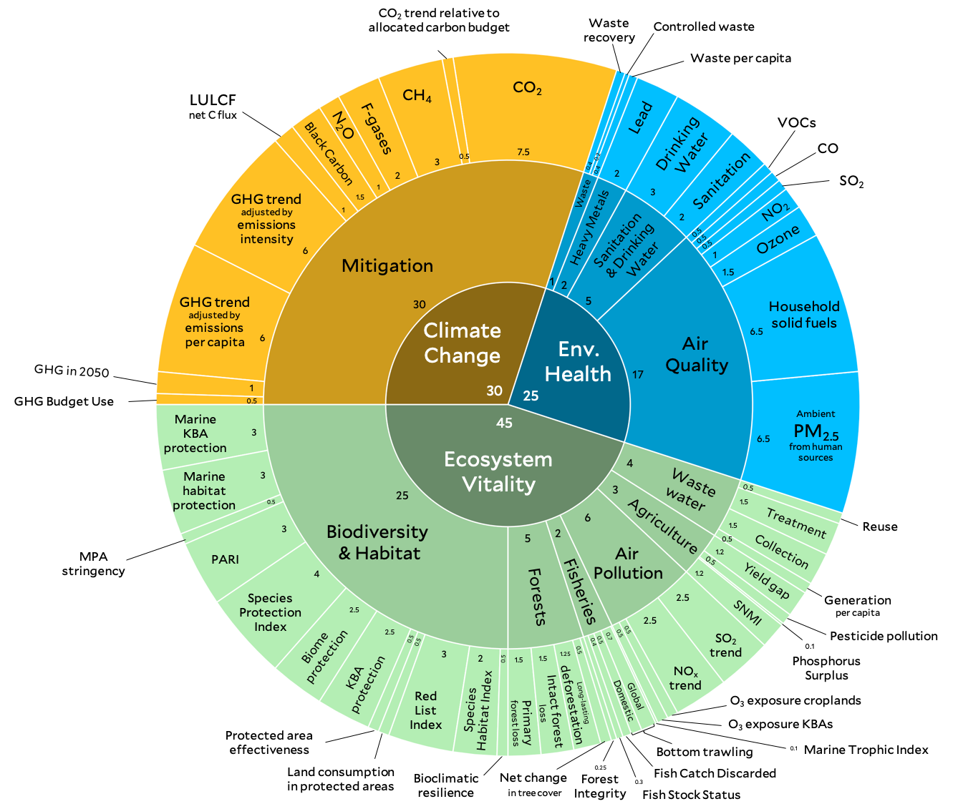
EPI framework, 2024

Slide 6
Global Insights from EPI Rankings
The Environmental Performance Index (EPI) ranks countries based on their environmental performance across various indicators, such as air quality, climate change policies, and biodiversity protection. These rankings provide a snapshot of global efforts to achieve sustainability goals.
In the 2024 EPI, Estonia ranked first, performing strongly in biodiversity conservation with a significant portion of its land and seas protected. Countries’ wealth is a strong predictor of their overall environmental performance.
Bangladesh ranked 175th out of 180 countries in the 2024 EPI, according to data from the Ministry of Environment, Forest and Climate Change of Bangladesh. The majority of low-scoring countries have prioritised economic expansion above sustainability or are dealing with civil upheaval and other crises.

Slide 7
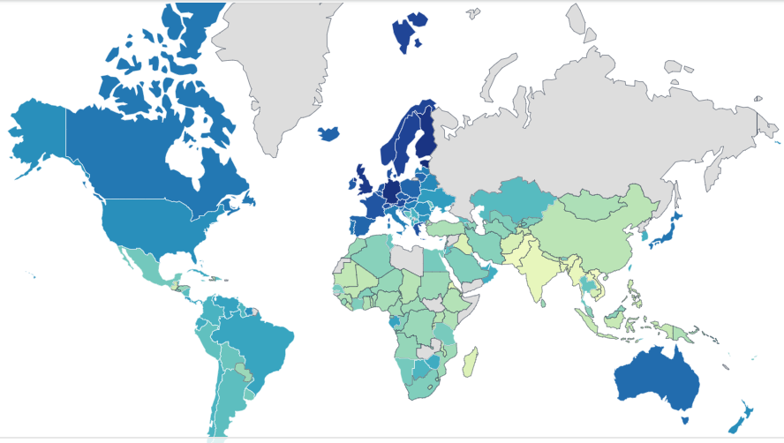
Scores: decreased from deep to light

Slide 8
Example of Country's Performance
European/development countries
Asian/developing countries
Country | EPI Score 2024 | Change (2014-2024)
Estonia | 75.70 | 17.60
Luxembourg | 75.10 | 4.20
Germany | 74.50 | 4.60
Finland | 73.80 | 8.30
UK | 72.60 | 2.10
Country | EPI Score 2024 | Change (2014-2024)
Bangladesh | 28.10 | 2.40
India | 27.60 | 4.70
Myanmar | 27.10 | -2.70
Laos | 26.30 | 1.10
Pakistan | 25.50 | -4.00

Slide 9
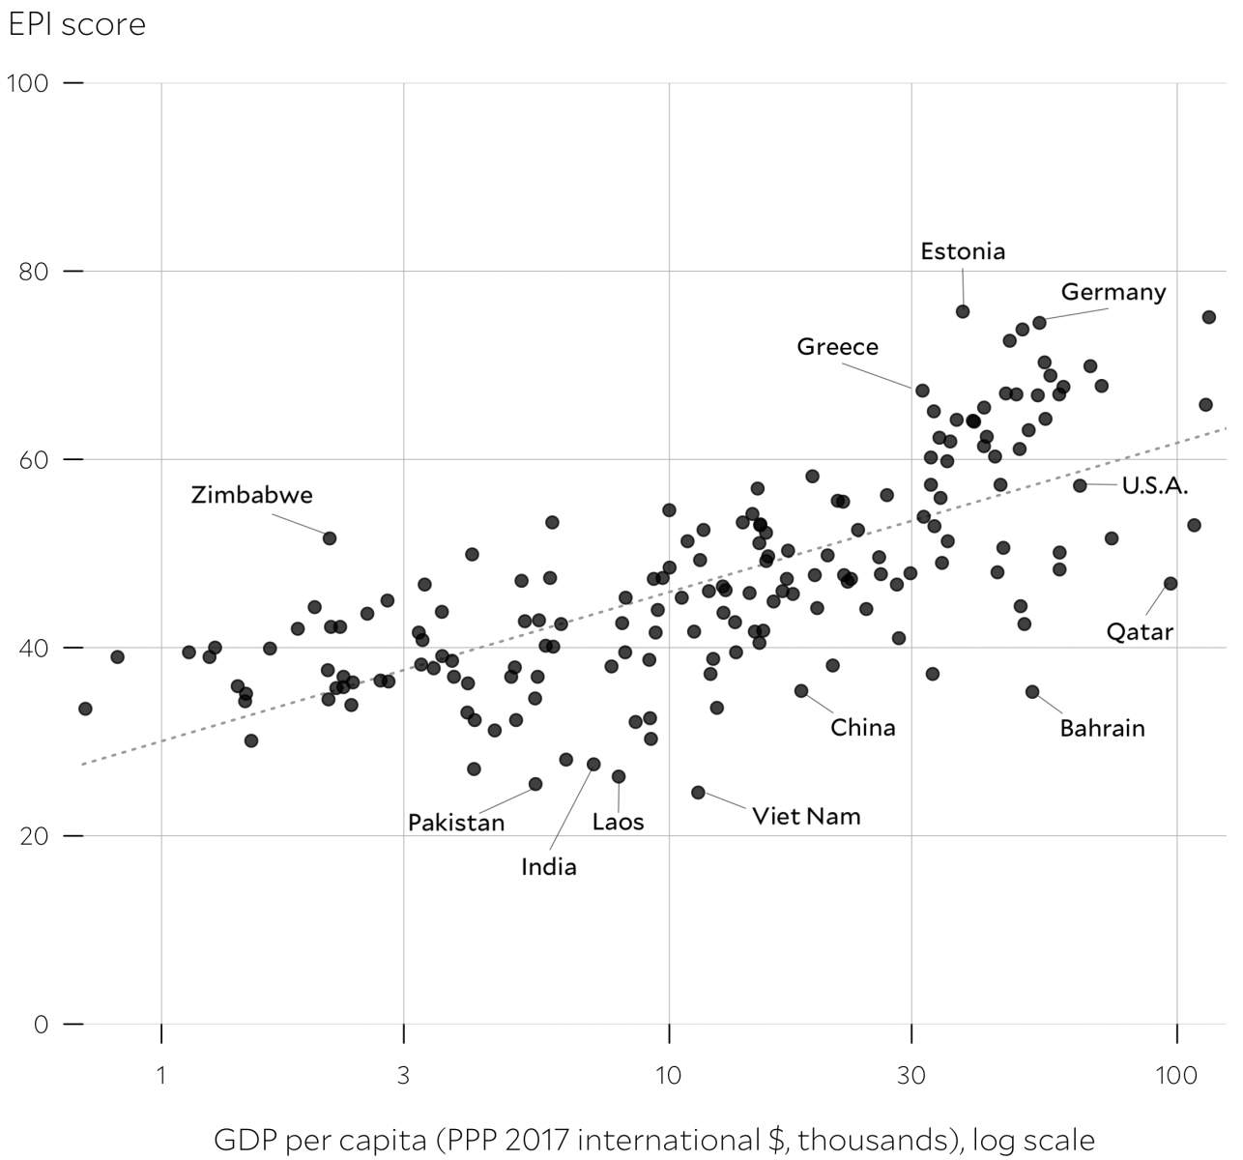
EPI scores and GDP

Slide 10
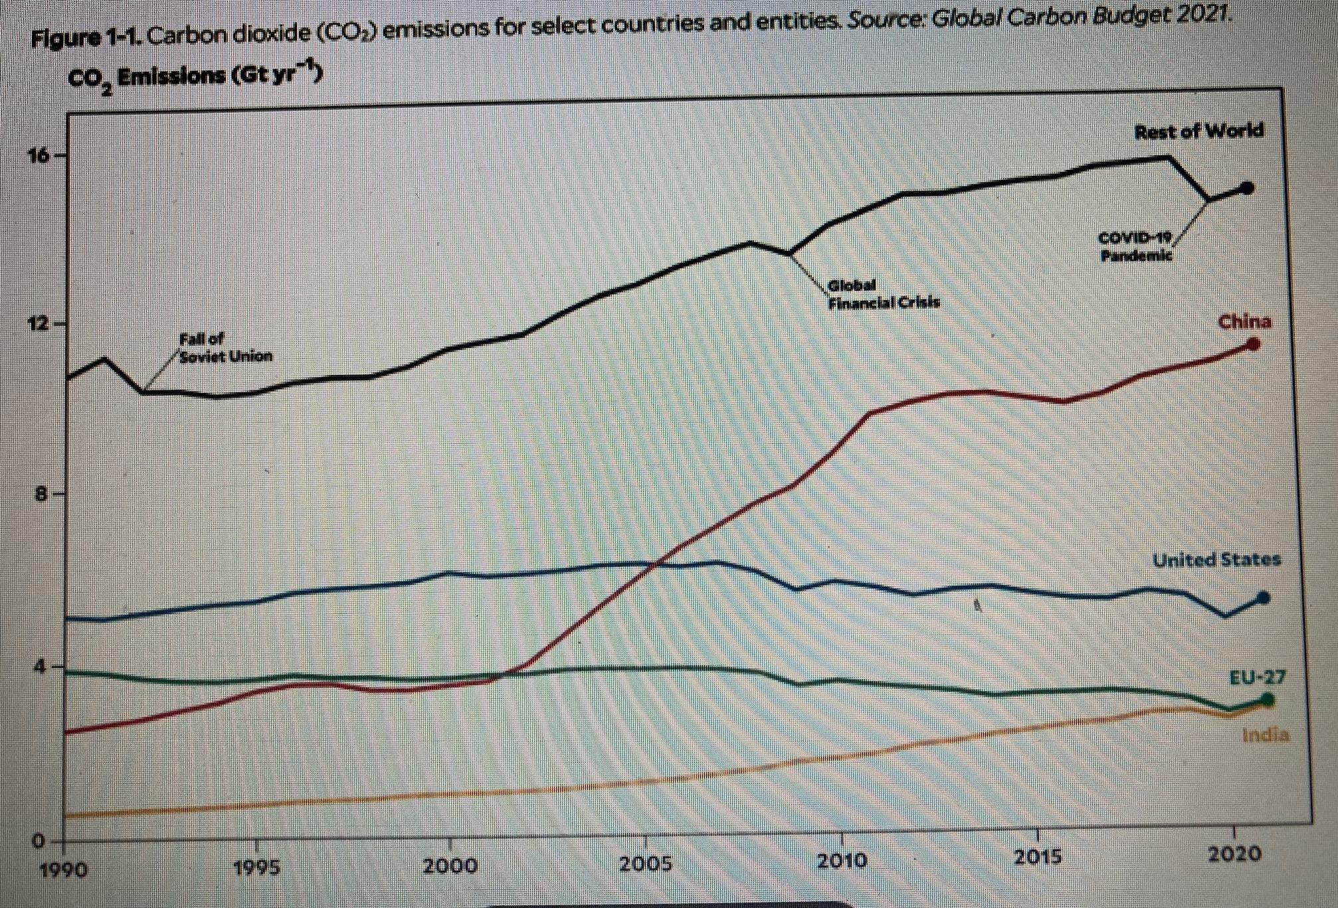
Carbon dioxide emissions countries

Slide 11
Significance of EPI
The Environmental Performance Index (EPI) statistics show that financial resources, excellent governance, human development and regulatory quality all play a role in boosting a country’s sustainability. EPI helps decision-makers to identify all these factors that contribute to top-tier performance.
By emphasising these connections, the EPI contributes to the promotion of sustainable development in support of a more ecologically secure and equitable future.

Slide 12
Criticism and Limitations of the EPI
Data Gaps: It may be noted that several low-income countries do not possess accurate data. Therefore, their evaluation could be partial or even biased.
Cultural Bias: Others have explained that the metrics benefit the countries of the West because they consider parameters that suit the West, like clean energy and policy compliance.
Dynamic Challenges: Some aspects of the environment are constantly evolving, which is why metrics should adjust to society’s constantly shifting pace. Examples of such aspects are plastic pollution and the sprawl of cities across the globe.

Slide 13
Conclusion
The Environmental Performance Index (EPI) is essential for driving global sustainability by helping nations set goals, track progress, and identify areas for improvement. High-ranking countries show the impact of strong policies while developing nations highlight the need for innovation and collaboration.

Slide 14
Thanks

